Slide 1
UNCOVERING THE GAMING INDUSTRY HIDDEN GEMS: A COMPREHENSIVE ANALYSIS OF VIDEO GAMES SALES
BY
M.Ruthra
M.Sangeetha
M.Sandhiya
S.Sandhiya

Slide 2
INTRODUCTION
PROJECT DESCRIPTION:
Video game sales analysis is the process of collecting and analyzing data about the sales of video games in order to understand market trends and consumer behavior. This type of analysis can be useful for variety of purposes, including identifying the most popular game sales analysis typically involves collecting data from Kaggle sources. It was generated by scrape by a include information about the number of units sold, the retail price, and the platforms on which the games are played. Once the data has been collected, it is typically analyzed using tableau. Video games sales analysis may be conducted by game developers, publishers, retailers and the other industry professionals. It is an important part of the video game industry, as it helps to understand the needs and preferences of consumers and to identify opportunities for growth and innovation.
Analyzing sales data from more than 16,500games. This dataset contains a list of video games with sales greater than 10,0000 copies. It was generated by a scrape of vgchartz.com.

Slide 3
1.1 overview
A Comprehensive Analysis of Vedio Games Sales:
Sales in EU-NA-JP Region
Sales per Genre
Top NA’s Selling Vg
Top 10 Japan Selling Vedio Games
Top 10 EU Sales Vg
Top 5 publishers
Total Sales
Genre with Rank
Dashboard
story

Slide 4
Purpose
The purpose of the project is to analyze the market of video games sales and its problems in recent days.It helps to understand the needs and preferences of consumers and to identify the oppurtunities for growth and innovation.
It allow us to understand games better and providing insite into the player game relationship .
The Construction of the game and its socioculture relevance.

Slide 5
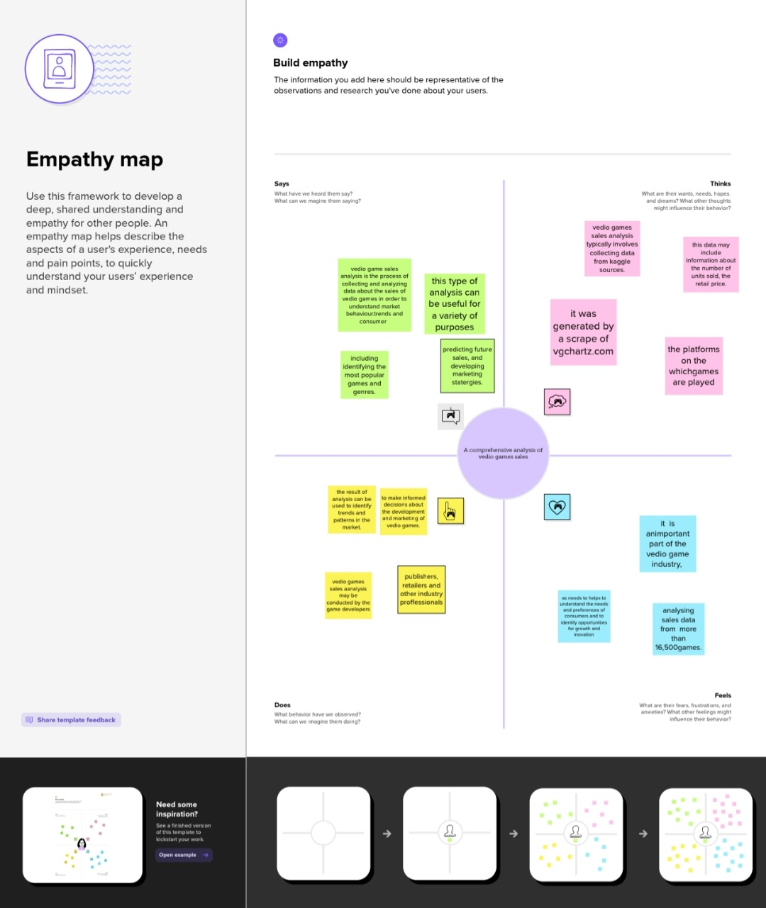
Problem Definition and Design Thinking
Empathy map

Slide 6

Ideation and Brainstorming Map

Slide 7
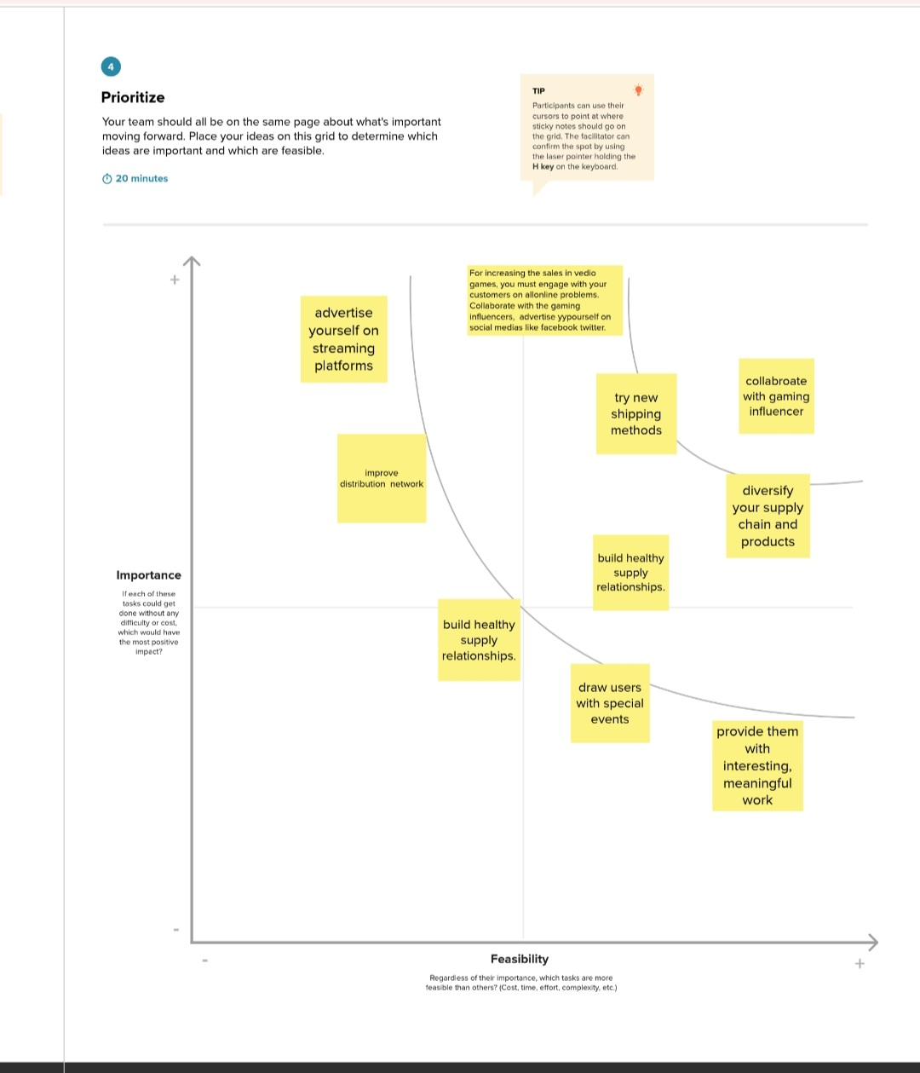


Slide 8
Result
The sales of gaming industry is not higher in the year of 1980.
The sales gradually get increased 40 percent in JP initially and found major rise in year of 2008.
Action games has more scopes compared to other gaming .
3DO has analyzed a lot about gaming and its ratio is 10.12 which is 10 times higher than other publishers.
The top EU sales Vg is Call of Duty:Black Ops II and Call of Duty:Modern Warfare 3.
Animal Crossing:Wild World is the top Japan sales.

Slide 9
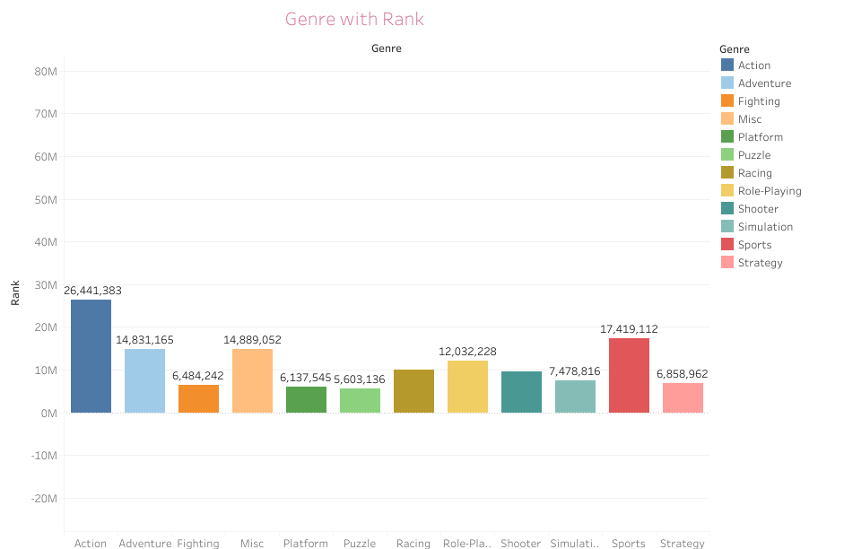
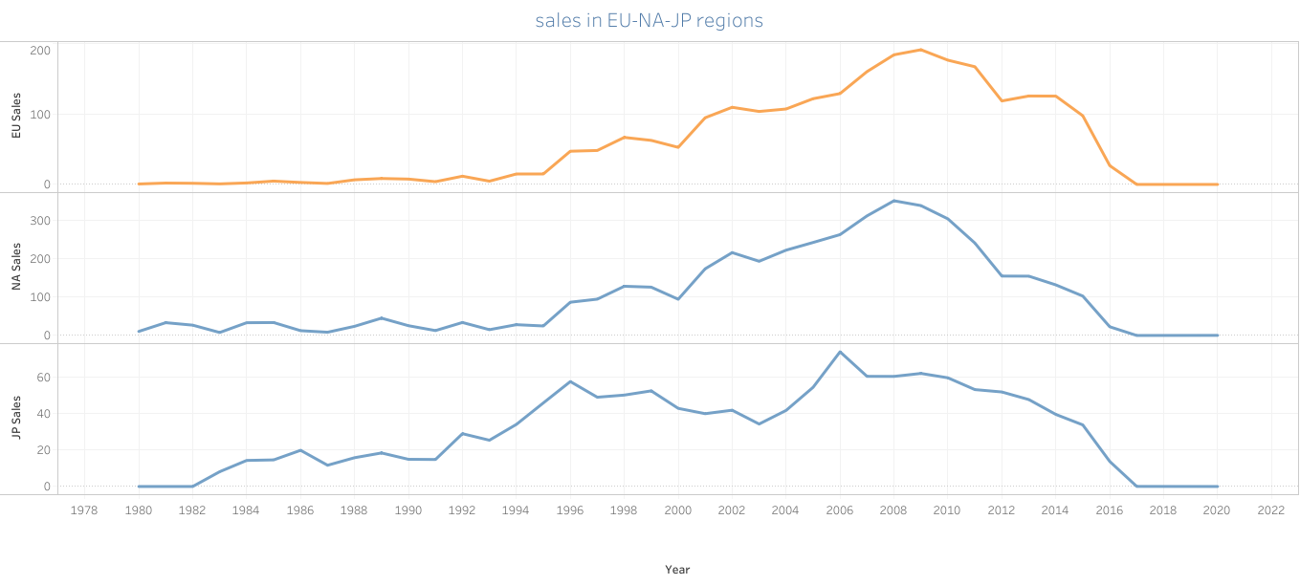
Charts

Slide 10
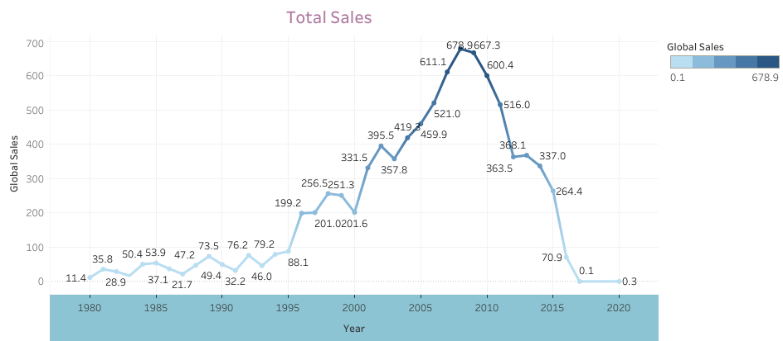
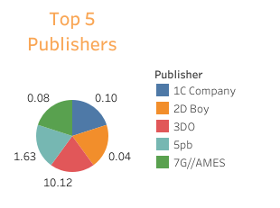

Slide 11
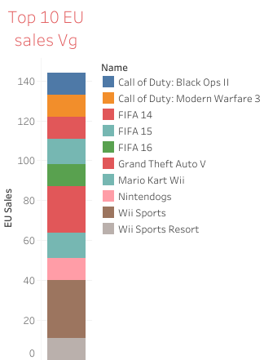
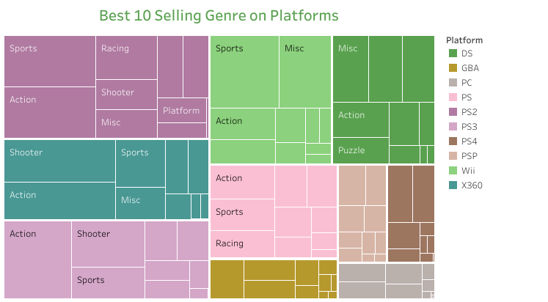
Charts

Slide 12
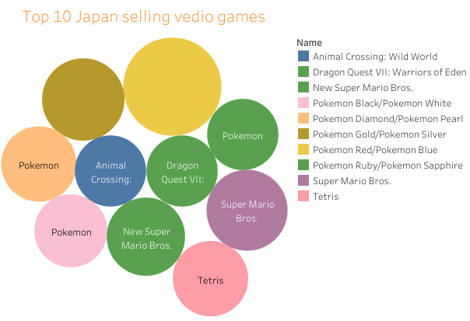

Slide 13

Dashboard

Slide 14

Vedio games sales story

Slide 15
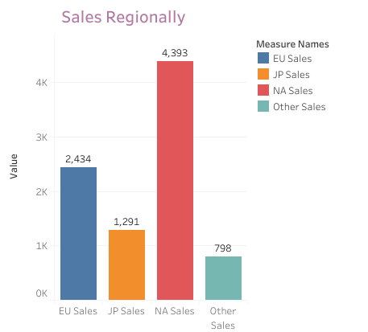
Sales regionally

Slide 16
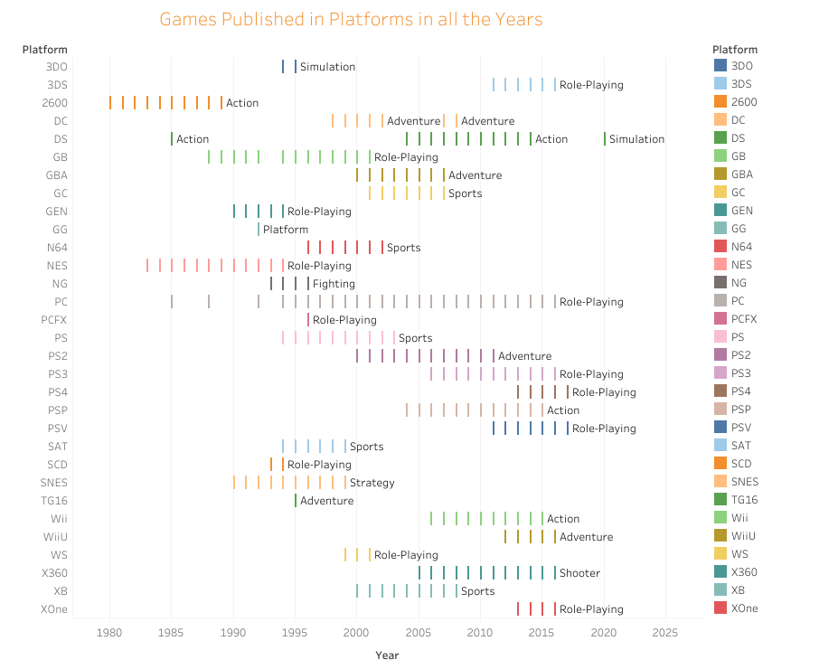
Games publishedin platforms in all the years

Slide 17
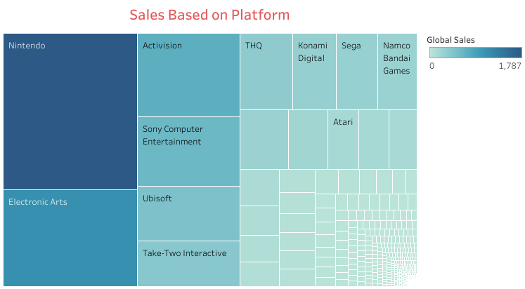
Sales Based on Platform

Slide 18
Advantages and Disadvantages
Advantages:
Finding New Marketing techniques through animation.
Innovating new gaming techniques.
Development in Software sector.
Providing Customer Satisfaction.
Diversity
Brain Booster:
Playing video games directly impacts regions of the brain responsible for memory, spatial orientation, information organizations, and fine motor skills. As people age, the importance of playing games tends to increase.
It could improve decision-making skills; compared to non-players, gamers who spend time daily with fast-paced games can react to questions or situations up to 25% faster.

Slide 19
Improved Life Skills
Video games involve taking risks, and the ability to strategize. It teaches patience, perseverance, and the right judgment. It also helps people find new friends and social connections. Besides, gamers become better at critical analysis and learn to concentrate on tasks at hand to completion.
May Ease Anxiety and Depression
It has been found that people are more confident, energetic and emotionally positive when they play video games, which is exactly the opposite of what depression brings about.
People who feel depressed lack physical energy, find it difficult to carry out daily tasks and are generally pessimistic. Thus, playing can reduce the risks for depression, help with arthritis, and even be a therapeutic option for aphasia.
Painkiller
According to a study from the American Pain Society, video games, and more specifically 3D ones, could help reduce the brain’s response to physical pain.
Playing an attention-grabbing video game may distract one away from a painful activity and help them with chronic pain conditions, especially children.

Slide 20
Training and improvement of physical and mental abilities
It has been proven in some studies that if we play video games daily, we can improve our visual attention, be more efficient in changing tasks, be faster in tasks where we have to perform a visual search or discriminate objects by their Shape / color.
Also among other benefits, it contributes more effectiveness in the monitoring of multiple objectives .
Other researchers have carried out training studies corroborating that the practice of video games also improves the execution of divided tasks and mental rotation.
Encourage teamwork
In team games, players will also develop Group work skills Since, at times, they have to be united to overcome some challenge.
In addition, it also allows them to develop other skills such as quick thinking to act satisfactorily before any problems that have been presented or even work under pressure not to lose the game.
Increase the sense of competence and self-esteem
The use of video games also creates feelings of self-esteem and competition in players game after game. As you overcome the different challenges and levels, you feel better with yourself and able to meet the following objectives.

Slide 21
Disadvatages
Can create addiction
It is common to hear that there are people who are Addicted to video games , However and in spite of the studies that have been done on the matter, to date of today one can not prove that to play with the videojuegos can create addiction.
Salguero (2009) talks about that some people at a given moment, acquire a pathological fixation by an object or activity. Even so, we have to analyze the person and ask ourselves why he has reached that point.
In addition, we also have to point out that there are activities that are tremendously entertaining and absorbing, so you can spend more time than usual.
Could Limit Academic Process
Although video games can improve the strategic thinking decision-making process, they can also deteriorate them.
Students who use their free time to play video games can struggle to keep up with school/college. Most gamers have been seen to procrastinate on their studying, or they simply ignore a deadline just to play their favorite game.

Slide 22
It increases the aggressiveness of the player and they are violent
Some games are very aggressive and violent. Sometimes, this content is not only limited to physical aggressions but also also enters into ideologies. There is a wide range of research in this area in which a clear conclusion can not be reached as to whether videogames create or aggressiveness In their players.
Some argue that its effect is short-term.
It can affect the life of the players
If you do not have control of its use, it can affect our life in a negative way; Thus affecting our school performance, the family and our day to day life in general.
Social Replacement
Video games often act as a replacement for real-time human connections. People who find themselves playing hours upon hours of video games may find themselves losing touch with the relationships they’ve built with other people.
People argue that with internet -connected games, they can easily hang out with friends and families without ever leaving home, but this type of virtual get together is no replacement for actual face-to-face interaction.

Slide 23
Application
It helps us to understand the market trends and customer needs .
It also make us to get the future trends in gaming industry.
It enrich retail industry, IT industry and Marketing industry.
It gives the scope of data analytics.
The findings of the researched literature reveal that video games present multiple opportunities for practical uses outside of entertainment. Educators use video games as tools within their classrooms, and students often feel an increased level of motivation to participate when games are involved. With the aid of accessible hardware and software, people with disabilities can have better access to playing games. In doing so, people can learn how to use assistive technology. Due to their online nature, many video games present opportunities for players to develop friendships and strengthen their leadership skills. A further analysis of this chapter’s findings will be the focus of the next chapter..

Slide 24
Going forward, there are several areas for further research into the practical applications of games. Within education, researchers can investigate how using games in a curriculum affects students’ learning outside the classroom. For example, with children using Minecraft both within and outside of classrooms, it is possible that children may continue their learning beyond the hours of school. Researchers can focus on how the inclusion of accessibility options affects the social lives of people with disabilities. These options allow more people to play games, and it is possible that people with disabilities expand their social circles due to the social nature of some games. Finally, further attention can be directed toward the benefits of social spaces in games. Research can also be conducted on the negative aspects of social spaces in games. Harassment plagues many social games, so researchers can conduct surveys on how this affects gamers who use those platforms.
The benefits of videogames have also reached education with game-based learning. This teaching method uses beneficial aspects of videogames to transmit knowledge to students. It is based on three key factors:
It breathes life into education: it transforms learning into an enjoyable, thrilling game without boring lessons. Students assimilate and retain information almost without noticing.
It boosts motivation: students are the main characters in the story and their success is rewarded with medals, extra lives, bonuses, etc. This captures and keeps their interest in learning.
It gives opportunities to practice: students can apply the knowledge they acquire without getting into dangerous situations. This is what flight and navigation simulators, for instance, are all about.

Slide 25
conclusion
It helps us to understand the gaming industry and its requirements clearly.
It make us to find new oppurtunities for the employees to find out the new gaming techniques including AI, Animation and cloud based games.
It helps for financial growth of gaming industry.
Customer gets entertainments and brainstorming games
It develops the critical thinking and problem solving skills of the player

Slide 26
Future Scope
Gaming Designing is one of the most upcoming courses.
Cloud gaming, digital distribution and streaming are future gaming trends.
Artificial intelligence in gaming is to figure out the player’s ability and emotional state of the player.
Revenue of the gaming industry will be increased than movies and sports industry In future.
Innovation of new technologies in software sector.
Game Designing is one of the most upcoming Courses for students who wanted to make a Game Designer Career in India in animation. The gaming industry is rapidly growing at a pace of 50% per annum. There is a very wide and bright future in game design in India.
Working in the gaming industry can be one of the lucrative career options in 2023. Games that people play every day need to be built, updated, and maintained by someone. As a result of their high salaries, game developers are in high demand all over the world.
The gaming industry has grown tremendously over the past decade, with the market value expected to reach 3.6 billion by 2025. As technology continues to evolve, the future of gaming looks promising, with innovations such as AI, virtual reality, and the metaverse set to revolutionize the industry.

